Slide 1



customer review
View in Power BI
Last data refresh:
4/14/2023 7:45:10 PM UTC
Downloaded at:
4/17/2023 6:49:17 AM UTC

Slide 2
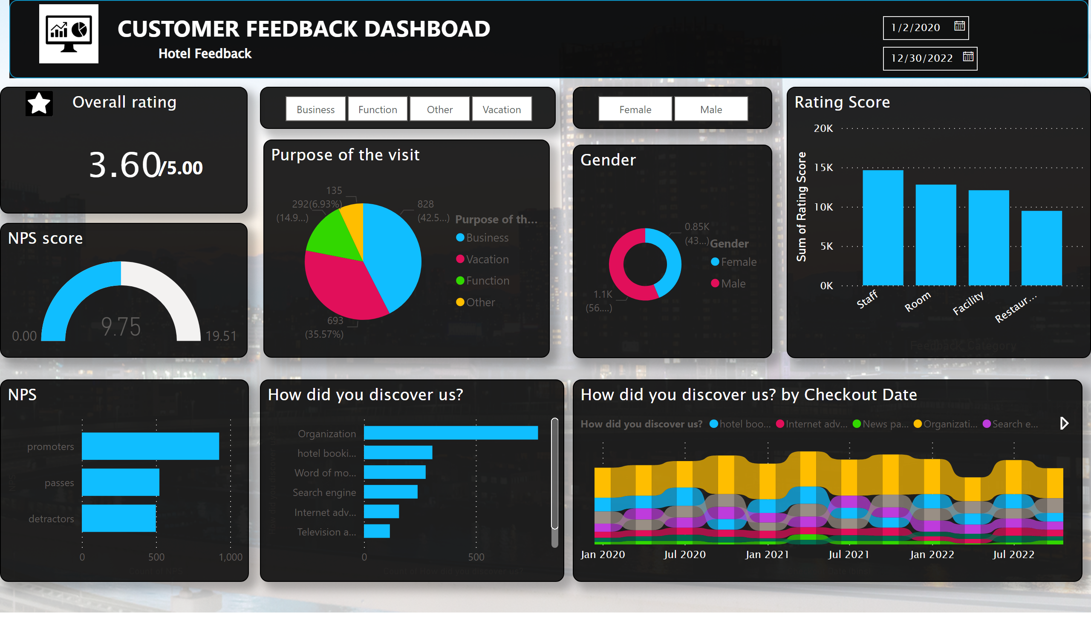
Page 1
Notes:
slicer
No alt text provided
slicer
No alt text provided
gauge
No alt text provided
NPS
No alt text provided
Overall rating
No alt text provided
Gender
No alt text provided
How did you discover us?
No alt text provided
How did you discover us? by Checkout Date
No alt text provided
Rating Score
No alt text provided
Purpose of the visit
No alt text provided
shape
No alt text provided
textbox
No alt text provided
slicer
No alt text provided
image
No alt text provided
textbox
No alt text provided
textbox
No alt text provided
image
No alt text provided

